Slide 1
BIG DATA IN MEDIA AND ENTERTAINMENT
BY: Ankit Chaudhary(31470815)
Aditya Chavan (31480553)
Rohit Pahuja(31396683)
Vinay Burhade(31477391)

Slide 2
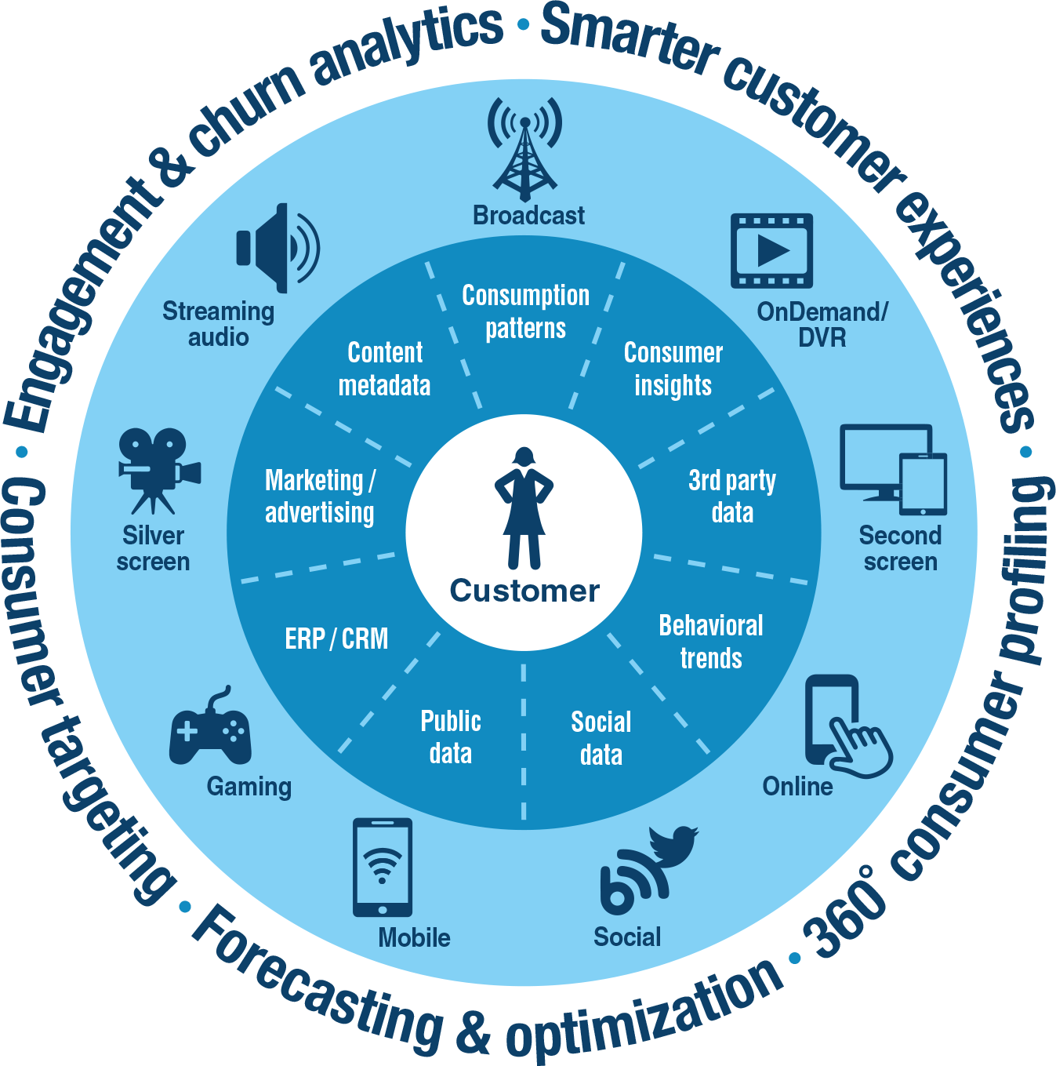

Slide 3
Introduction
The M&E industry has frequently been at the forefront of adopting new technologies
Smartphones and other digital media are becoming major source of entertainment, hence generating incredible amounts of data
Big Data analytics must be embraced to create a connection with the customers
The challenge is extending integration of multiple data streams and analyzing data to derive actionable insights
With the use of insights from Big Data, entertainment companies could understand when customers are most likely to see content and the device they will be using when they view it.
Example: Netflix

Slide 4
4 V’s of Big Data
1. Volume
Just think of all social media interaction, posting or sharing reviews, RFID , sensors, MRI images, audio files, web pages, web logs, photos and video clips that we produce and share every second
With big data technology we can now store and use these data sets with the help of distributed systems, where parts of the data are stored in different locations, connected by networks and brought together by software. Eg. HDFS, because of it we can replicate data on different nodes in Hadoop cluster.
2. Velocity
Velocity is the frequency of incoming data that needs to be processed.
Think about how many SMS messages, Facebook status updates, or credit card swipes are being sent on a particular telecom carrier every minute of every day, and you’ll have a good appreciation of velocity.

Slide 5
4 V’s of Big Data
3. Variety
Structured Data: Data that’s well defined in a set of rules
Structured data is augmented/ increased by unstructured data which is where things like social interactions, audio files, web pages, web blogs are put – anything that can be captured and stored but doesn’t have meta model [set of rules to frame a concept or idea].
Unstructured Data: Data with no rules
One of big data goal is to use unstructured data and make sense of it.
80% of worlds data is unstructured, therefore can’t easily be put into tables and relational DBs.
With Big DATA we can store both types of data i.e. structured and unstructured
4. Veracity
Veracity refers to the trustworthiness of the data.
Veracity refers to an uncertainty of data available, which makes it harder for the companies to react quickly and make appropriate solutions. Accuracy is the major issue in such a big data environment.
To make right decisions, the data must be clean, consistent and consolidated.

Slide 6
CHALLENGES
SECURITY
INFRASTRUCTURE
COMPUTING
DATABASE
DATA TRANSFER

Slide 7
SECURITY
Data must be protected from intrusion and corruption
Validation of endpoint
Securing distributed framework calculation and other processes
Securing data in real time
Protecting access control method communication and encryption

Slide 8
Infrastructure
Large amount of space is needed to store the data
This data can be stored on the servers which take significant infrastructure space
Computing
A lot of computing power is needed to analyse the big-data sets
Computing needs to be cost effective as too much data is being generated every day (2.3 trillion gigabytes) and 40 zettabytes will be created by 2020.

Slide 9
Database
RDBMS is less useful for computing tasks in big data
RDBMS is not scalable and hence cannot be used to handle big data which is usually measured in petabytes, exabytes, zettabytes
Traditional database systems like Oracle RAC can cost millions to store just 20 terabytes of data
Data transfer
Transferring data is a critical issue
How effectively can zettabytes of data be transferred to the end user?
How the data backup will be made?

Slide 10
Existing solutions
Usage Non RDBMS databases (NoSQL) like MongoDB and DynamoDB
Using distributed computing systems like Hadoop, Hive, Pig, etc.
Leveraging machine learning to fight cyber crimes, for eg. Amazon Macie
Usage of optimized algorithms for cost optimization
Usage of Hadoop and Map-Reduce for data processing
Data lakes can be used to store data you don’t analyse at the moment

Slide 11
Suggested Solutions
Storing obsolete data in compressed state
Storing obsolete and historical data in compressed form
This data can be fetched back whenever needed, hence not occupying the current computing space
2. Automatic summarization of data
Software application for automatic summarization of data which includes text in order to send only the data which is important and required by the end user
The end user can set the tags for the required data using specific keywords.
3. Lossless compression technique:
Algorithm to compress the data compressing yet not compromising the quality of the data over cloud storage systems

Slide 12
THANK YOU

